Slide 1

Air quality analysis
Sooyeon Choi
Summer 2021, Phase 02

Slide 2
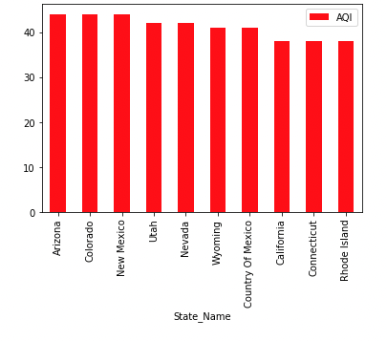
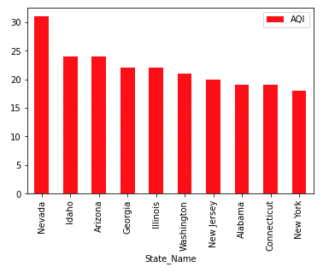
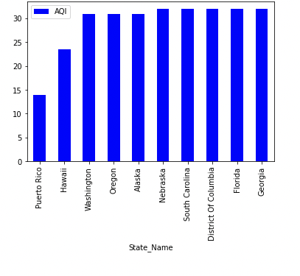
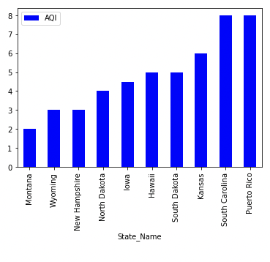
Nitrogen
dioxide
ozone
Notes:
Ozone- Arizona Colorado newmexico/ hawai washingon Oregon
No2 = Nevada Idaho Arizona / montana Wyoming newhapshpier

Slide 3
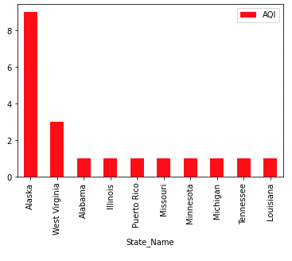
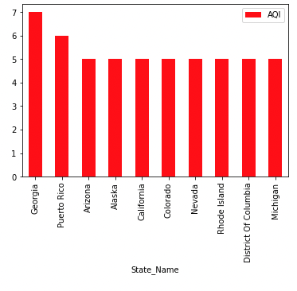
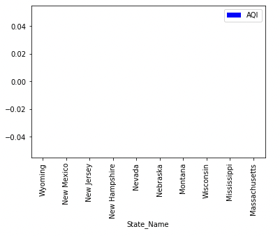
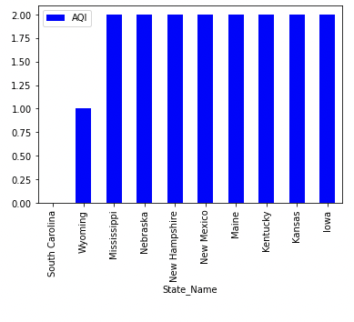
Carbon monoxide
Sulfur
dioxide
Notes:
So2 Alaska wv alambaba/ Wyoming newmexico new jersy
Carbon – Georgia Arizona alsak a / south Carolina Wyoming missiipi

Slide 4
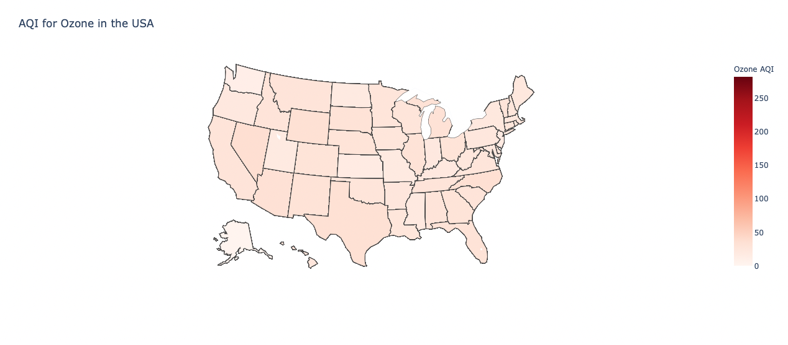
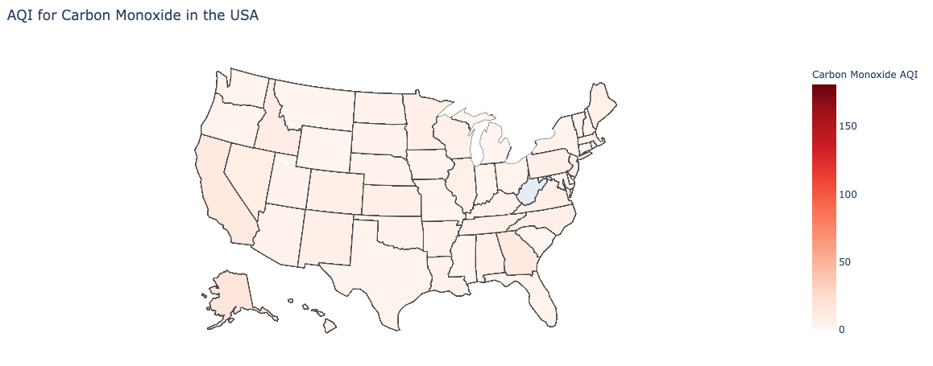

Slide 5
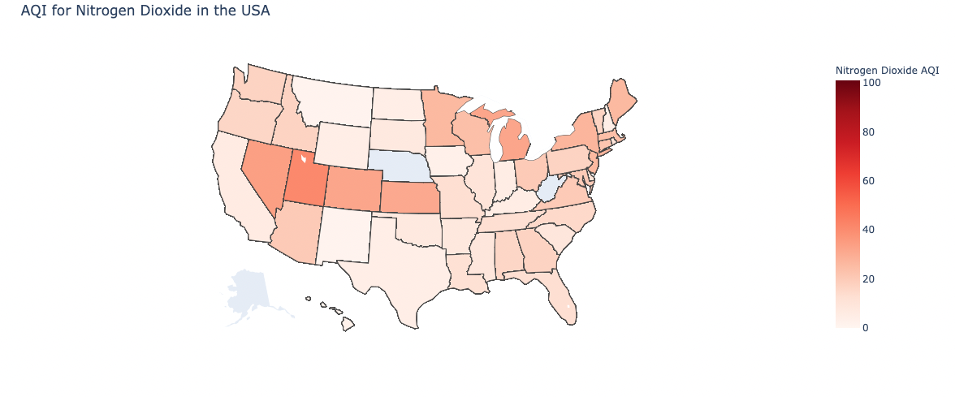
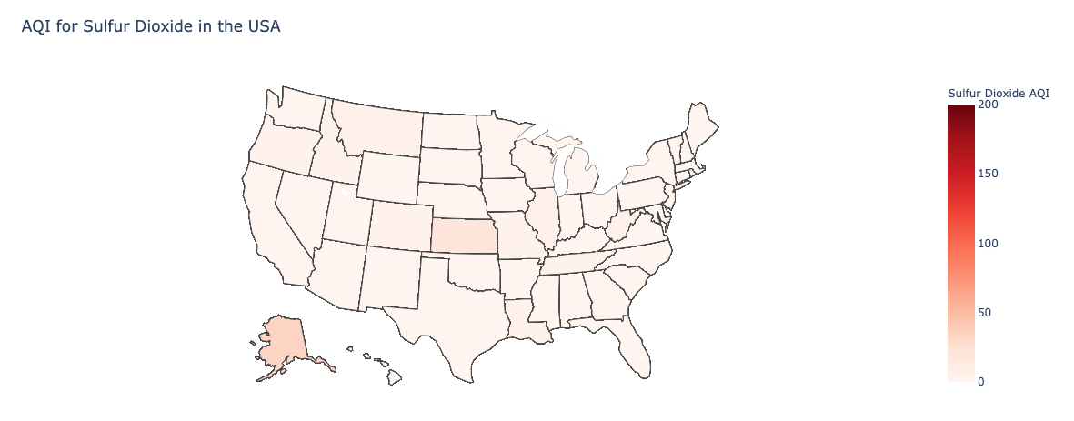

Slide 6
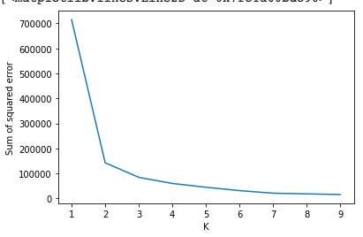
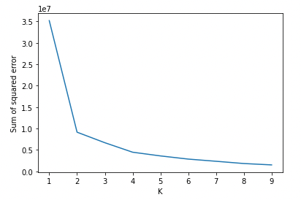
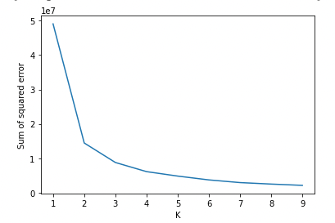
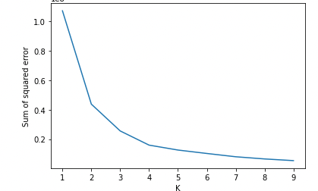
K means clustering
Elbow Method
Ozone
Carbon Monoxide
Sulfur
Dioxide
Nitrogen
Dioxide
Notes:
3,4,3,4

Slide 7
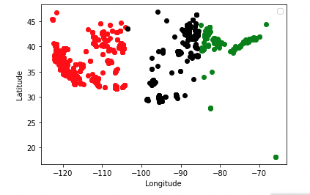
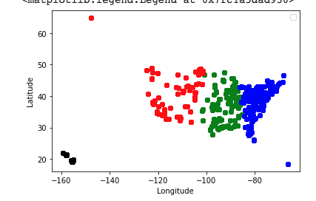
K-means Clustering
Ozone
Sulfur Dioxide
Notes:
Ozone – more than 100, sulfur dioxie- 80

Slide 8
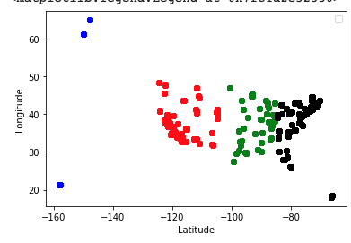
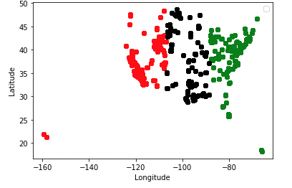
K-means Clustering
Carbon Monoxide
Nitrogen Dioxide
Notes:
Carb- 10, nit- 80

